Slide 1
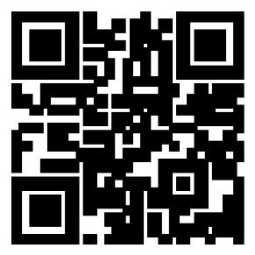
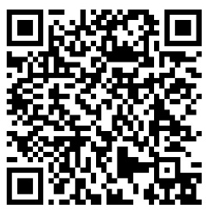
THE
IG Update
Volume 24-4, April 2024
Non-Support to Family Members
Per Army Regulation 608-99 (Family Support, Child Custody, and Parentage), Soldiers must manage their personal affairs in a manner consistent with the Army’s core values.
As it relates to Family members, Soldiers have an obligation to:
• Maintain reasonable contact with Family members so their financial needs and welfare do not become official matters of concern for the Army;
• Conduct themselves in an honorable manner with regard to parental commitments and responsibilities;
• Provide adequate financial support to Family members, and
• Comply with court or child support enforcement agency orders.
It is a commander’s responsibility to ensure their Soldiers comply with AR 608-99 and the obligations as listed above.
Should a Family member contact an IG alleging non-support, the IG will determine if the Family member has forwarded/filed a complaint through command channels with the Soldier’s immediate commander.
If he/she has not, the IG will provide assistance in doing so, and may also refer the Family member to the local or servicing legal assistance office.
Once the command responds to the Family member, the IG generally closes the case.
However, if the command fails to respond within a reasonable period of time, the local IG will notify the next higher commander and continue to allow the chain of command to resolve the issue. If no further action occurs, the IG may need to contact the Directing Authority.
Commander’s actions
In addition to responding to the complainant (in writing) within a reasonable period of time after receiving the inquiry or allegation of non-support, commanders would typically take the following actions:
• Inform the Soldier about the nature of the inquiry or allegation, in writing using DA Form 4856, and, if necessary, advise the Soldier of his/her rights (using DA Form 3881) before questioning the Soldier.
• Gather relevant information, supporting documents, and consult with the local staff judge advocate (SJA) to determine the Soldier’s financial support obligation.
• Counsel the Soldier. A written counseling (DA Form 4856) may form the basis for adverse administrative or UCMJ action if the Soldier fails to follow the commander’s order.
• Order compliance. If the commander determines the Soldier failed to comply in the past or indicates any unwillingness to comply in the future, the commander should order the Soldier to comply with the provisions of AR 608-99.
As always, commanders should consult their local Staff Judge Advocate (SJA) with any questions.
Unit patch/logo
goes here
Your Unit Name
Commanding General
MG Soldier Q. Public
Command Sergeant Major
CSM Soldier Q. Public
Command Inspector General
LTC Soldier Q. Public
Inspector General NCOIC
SGM Soldier Q. Public
IG Points of Contact
Unit IG Office
Building 1234
Hooah Drive
Fort Swampy XX 55555
AR 608-99 (Family Support, Child Custody, and Parentage)
Accessible via Army Publishing Directorate or this QR code.
https://ig.army.mil

